Slide 1
Data Analytics Report on Adventure Works
Presented by Group – VI

Slide 2
Introduction
Adventure Works is a company which deals in sports gear and fitness accessories .It specializes in the sale of sports bikes , clothing and accessories related to it.
In this report, we shall dive deep into the necessary performance metrics and key details which are relevant to understand this comprehensive BI report and relay that information unto our audience.

Slide 3
Business Questions
Who are the top 5 customers with the highest sales ?
Which are the top countries were most of the sales took place ?
Which are the top 5 products with respect to sales ?
What do we know about the monthly profits?
What do we know about the yearly profit and sales?

Slide 4
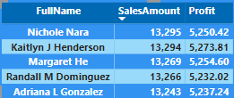
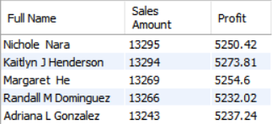
Who are the top 5 customers with the highest sales and profit ?
Our BI visual:
Our SQL output:

Slide 5
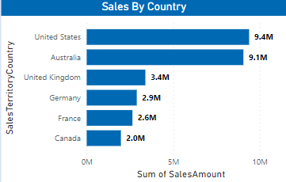
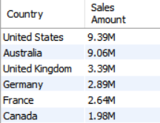
Which are the top countries were most of the sales took place ?
Our BI visual:
Our SQL output:

Slide 6
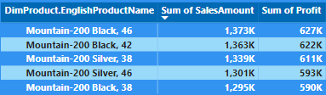
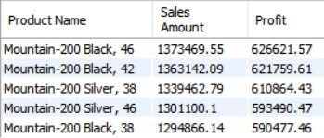
Which are the top 5 products with respect to sales ?
Our BI visual:
Our SQL output:

Slide 7
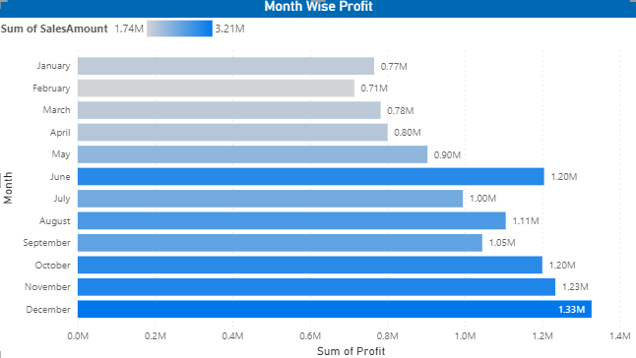
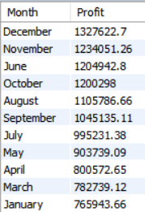
What do we know about the monthly profits?
Our BI visual:
Our SQL output:

Slide 8
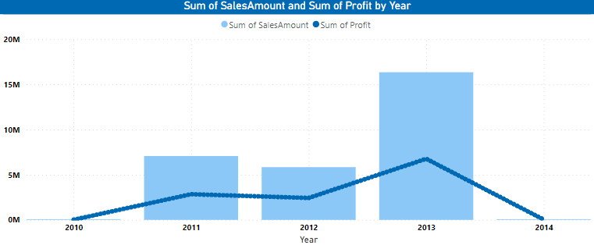
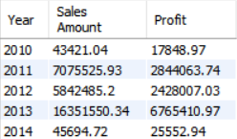
What do we know about the yearly profit and sales?
Our BI visual:
Our SQL output:

Slide 9
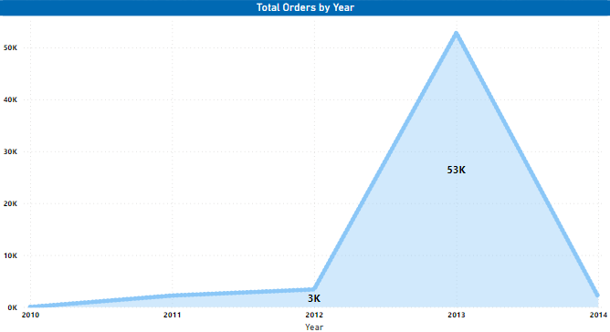
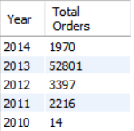
What do we know about yearly orders ?
Our BI visual:
Our SQL output:

Slide 10
Conclusion
In conclusion, the end-to-end journey of working on this project has been immensely gratifying. Witnessing the entire process unfold, from the project’s inception to its completion, has offered a distinct perspective on both the visuals and the underlying data. The satisfaction derived from this experience fuels our enthusiasm to undertake more such projects, delving into increasingly complex datasets in the future.

Slide 11
Thank You

